Slide 1
Building a Sovereign Cloud Infrastructure
Technical Considerations · Canonical Event Notes & PERSONAL RESEARCH · July 2026
Topics: Kernel & Virtualization · EU Regulations · Full-Stack Sovereignty OpenStack · Ceph · KVM · MAAS · Network Design · Cluster Architecture
Ihonosetale Oseghale – Masters Research
Notes:
Achieving Data Sovereignty for EU Enterprises Through European Cloud Infrastructure: A Comparative Analysis of Technical Capabilities and Regulatory Compliance

Slide 2
Agenda
Philip Williams · Tytus Kurek · David Beamonte
1
Why Sovereignty Matters
Geopolitics, regulation, economics
2
EU Regulatory Landscape
GDPR, DORA, CRA, NIS2
3
Technical Foundations
Kernel, virtualization, hypervisors
4
Sovereignty Across the Full Stack
Hardware to application
5
Open Source as Foundation
KVM, OpenStack, Ceph, Ubuntu
6
Building the Cloud — Step by Step
Physical design to Customer Zero
7
Canonical Products & Reference Adopters
MicroCloud, MAAS, Ceph
8
Key Takeaways
Notes:
Achieving Data Sovereignty for EU Enterprises Through European Cloud Infrastructure: A Comparative Analysis of Technical Capabilities and Regulatory Compliance

Slide 3
Why Sovereignty Matters
Three converging drivers
GEOPOLITICS
REGULATION
ECONOMICS
Dependency on foreign (mostly US) hyperscalers is increasingly seen as a strategic risk. Governments want control over critical digital infrastructure, especially amid rising global tensions.
A wave of EU legislation directly affects cloud and digital infrastructure: GDPR, DORA, NIS2, CRA, AI Act — all create compliance obligations that are easier to meet with sovereign, EU-controlled infrastructure.
Cost control and avoiding the lock-in pricing power of proprietary vendors. Open-source stacks give you price transparency, negotiating power, and exit options that hyperscalers don't.
" Necessary but not sufficient — open source alone doesn't make you sovereign; operations, data placement, and the full stack matter too. "
Notes:
Achieving Data Sovereignty for EU Enterprises Through European Cloud Infrastructure: A Comparative Analysis of Technical Capabilities and Regulatory Compliance

Slide 4
EU Regulatory Landscape
Regulations vs. Directives — know the difference
EU REGULATIONS — directly applicable
EU DIRECTIVES — transposed nationally
▸ GDPR — General Data Protection Regulation
▸ NIS2 — Network & Information Security Directive
▸ DORA — Digital Operational Resilience Act
▸ Each member state writes its own national law
▸ CRA — Cyber Resilience Act
▸ 27 different national implementations exist
▸ AI Act — risk-based AI governance
▸ Track the implementing law of each country you operate in
Apply as written, identically in ALL member states. No national translation needed. Companies comply directly.
Sets the required outcome; member states choose how. Compliance means tracking 27 national rulebooks.
Practical consequence: GDPR / DORA / CRA compliance is largely uniform across the EU. NIS2 means tracking 27 national rulebooks.
Notes:
Achieving Data Sovereignty for EU Enterprises Through European Cloud Infrastructure: A Comparative Analysis of Technical Capabilities and Regulatory Compliance

Slide 5
Sovereignty Across All Layers of the Stack
A sovereign application on a non-sovereign layer below is NOT sovereign
SOFTWARE / APPLICATIONS
▸ Your workloads, services, APIs
OBSERVABILITY
▸ Monitoring, logging, alerting — Prometheus, Grafana
VIRTUALIZATION / CLOUD PLATFORM
▸ OpenStack · KVM · MicroCloud
NETWORKING
▸ Neutron · OVN · Open vSwitch · BGP · DE-CIX peering
STORAGE
▸ Ceph — object, block, file under your own control
OPERATING SYSTEM
▸ Ubuntu — open-source base layer
SYSTEM MANAGEMENT
▸ MAAS — Metal as a Service — bare-metal provisioning
HARDWARE / METAL
▸ Your own servers in colocation · sovereignty starts here
↑ Sovereignty must be verified at EVERY layer
Notes:
Achieving Data Sovereignty for EU Enterprises Through European Cloud Infrastructure: A Comparative Analysis of Technical Capabilities and Regulatory Compliance

Slide 6
Open Source as the Natural Foundation
~70% of organizations already agree — but it's necessary, not sufficient
70%
No vendor lock-in
Avoid pricing power and unilateral changes from proprietary vendors
Full auditability
Source code can be inspected, modified, and independently verified
Community resilience
KVM is contributed to by many companies — no single point of control
of organisations agree open source = no vendor lock-in
Operational control
You deploy, patch, and operate on your timeline
Cost predictability
No per-core licensing; cost scales with your usage, not vendor pricing
⚠ NECESSARY — BUT NOT SUFFICIENT
Open source alone doesn't make you sovereign. You also need: data placement in EU jurisdiction · EU-resident operations team · supply chain transparency · full-stack deployment from hardware to app.
Ubuntu
KVM
OpenStack
Ceph
MAAS
MicroCloud
Notes:
Achieving Data Sovereignty for EU Enterprises Through European Cloud Infrastructure: A Comparative Analysis of Technical Capabilities and Regulatory Compliance

Slide 7
Technical Foundation: Kernel & Virtualization
Understanding the base layer before building sovereign infrastructure
What is the Kernel?
3 Virtualization Techniques
• The kernel is the core of an OS — it talks directly to hardware
• Handles: memory allocation, CPU scheduling, system calls, drivers
• Kernel modules (.ko files) extend functionality at runtime
• The kernel expects full, privileged access to real hardware
• Inside a VM, the hypervisor becomes the real boss — the kernel inside the VM must not touch real hardware directly
FULL VIRTUALIZATION (Early VMware, 1990s)
Hypervisor intercepts all privileged instructions from the guest OS and fakes results. Slow — constant interception overhead. No hardware support needed.
PARAVIRTUALIZATION (Xen, 2003)
Guest OS source code is modified to 'know' it's in a VM and ask the hypervisor for privilege access. Faster, but requires OS patching.
HARDWARE-ASSISTED VIRTUALIZATION (Intel VT-x / AMD-V) ★ NOW STANDARD
Hypervisor Types
TYPE 1 — Bare Metal
CPU manufacturers added 'Hypervisor mode' and 'Guest mode' in silicon. No software tricks needed — hardware enforces isolation. Most efficient.
TYPE 2 — Hosted
Industry Migration
• Xen — used Dom0 for privilege mgmt; famous for paravirt
• KVM (kvm.ko) — turns Linux into a hypervisor; most adopted
• VMware ESXi, Hyper-V (Azure)
• Runs as an app on top of an existing OS
• Examples: VirtualBox, VMware Workstation
• Not used in production cloud infrastructure
• AWS & Alibaba: Xen → KVM
• IBM Cloud, Oracle Cloud: KVM
• Only Azure: customised Hyper-V (not KVM)
Notes:
Achieving Data Sovereignty for EU Enterprises Through European Cloud Infrastructure: A Comparative Analysis of Technical Capabilities and Regulatory Compliance

Slide 8
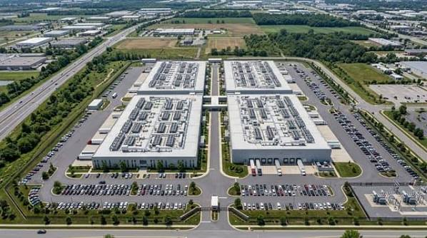
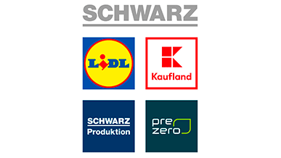
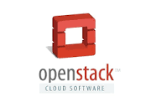
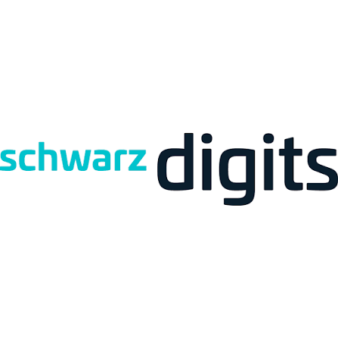

Building a Sovereign Cloud — Starting Point
Three decisions before you rack a single server
01
DETERMINE CUSTOMER ZERO
02
RENT CERTIFIED COLOCATION SPACE
03
COMMIT TO THE OPEN-SOURCE STACK
Decide whether you need a private cloud first, with the option to expand to other customers (multi-tenant) in future. Customer Zero = your first internal or anchor tenant — define their exact compute, storage, and networking requirements upfront. This becomes your minimum viable cluster size.
Start in a Tier III+ colocation facility — e.g. Frankfurt area (near DE-CIX) to gain access to major internet exchange peering. The facility provides: power, cooling, physical security, and connectivity. Build your own facility only after you've scaled and validated demand.
Technology choice: OpenStack + Ceph + KVM Deployment tool: Kolla-Ansible (or similar) OpenStack = open-source cloud OS controlling compute, storage, and networking across your data centre. This decision locks in your hiring profile and your training budget.
Colocation-Anbieter Frankfurt ITENOS
Notes:
Achieving Data Sovereignty for EU Enterprises Through European Cloud Infrastructure: A Comparative Analysis of Technical Capabilities and Regulatory Compliance

Slide 9
The Six Engineer Profiles You Must Hire
The scarcity of OpenStack and Ceph operators in Europe is itself a sovereignty constraint
① Platform Engineers
② Ceph Storage Engineers
③ SDN / Network Engineers
Python · distributed systems · COA certified OpenStack is written in Python — these are your cloud OS developers and operators.
Ceph cluster design, OSD tuning, erasure coding Critical scarcity role — very few certified Ceph engineers exist in Europe.
Two layers: Virtual: Neutron + OVN + Open vSwitch + VXLAN Physical: BGP, EVPN, DE-CIX peering
④ Deployment & Automation Engineers
⑤ Site Reliability Engineers (SREs)
⑥ Security & Compliance Engineers
Kolla-Ansible, Terraform, CI/CD pipelines Responsible for repeatable, auditable infrastructure-as-code deployments.
On-call, incident response, capacity planning Must maintain the 'illusion of infinite capacity' and never say no to a customer machine request.
BSI C5, ISO 27001, GDPR Art.28 DPAs Certification management, vulnerability patching, audit trail, access controls.
Notes:
Achieving Data Sovereignty for EU Enterprises Through European Cloud Infrastructure: A Comparative Analysis of Technical Capabilities and Regulatory Compliance

Slide 10
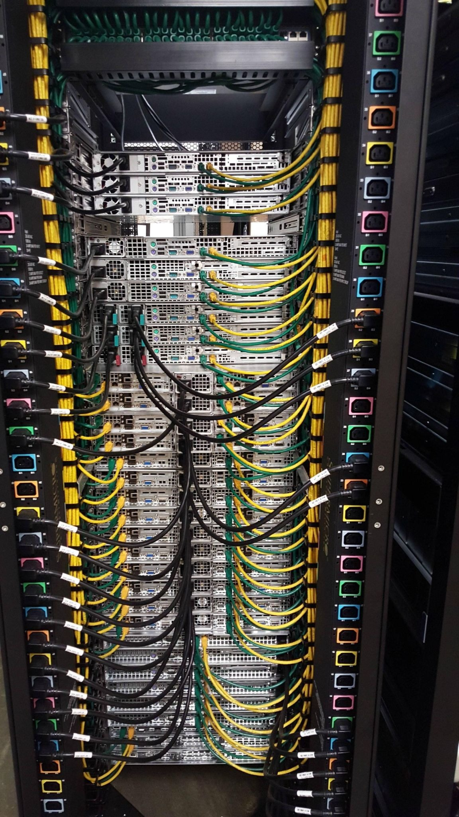
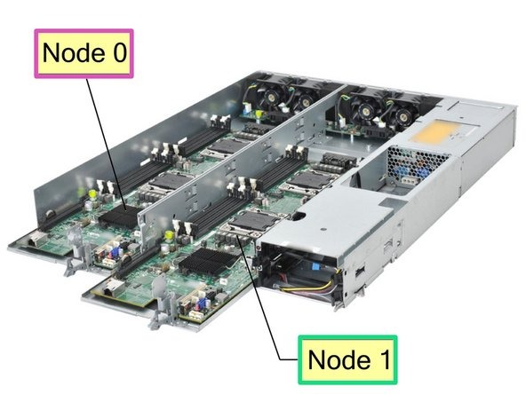
Step 1 — Physical Design: Node Roles & Hardware BOM
Design the cluster topology on paper before purchasing a single server
Node Roles in an OpenStack Cluster
Hardware Bill of Materials (BOM) — Example Scale
Control-plane nodes
×3
1U/2U servers, 2× 10GbE NICs, SSD for OS
Ceph storage nodes
×4
12–24× HDD/SSD per node, 2× 10GbE + 1× 25GbE
KVM compute nodes
×4
High-core CPU, 256GB+ RAM, 2× 10GbE NICs
Network/edge nodes
×2
DPDK-capable NICs, 2× 25GbE uplinks
ToR switches
×2
48-port 10GbE + 4× 100GbE uplinks
OOB management switch
×1
1GbE, connected to all BMC/IPMI ports
Routers / firewalls
×2
BGP-capable, DE-CIX-compatible
Total (example)
~15 servers, 5 network devices, 2 racks
Purchasing the servers/nodes. e.g 1U/2U pizza-box.
Each of these pizza boxes can be used as a compute, storage or control node, by installing the right parts & software
Notes:
Achieving Data Sovereignty for EU Enterprises Through European Cloud Infrastructure: A Comparative Analysis of Technical Capabilities and Regulatory Compliance

Slide 11
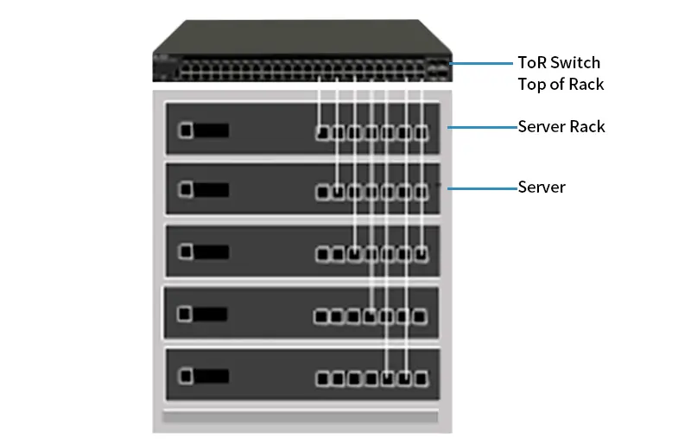
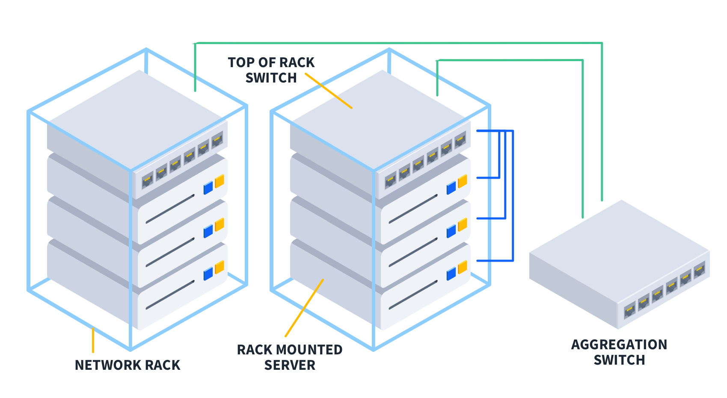
Step 1 — Physical Design: Node Roles & Hardware BOM
Design the cluster topology on paper before purchasing a single server
Node Roles in an OpenStack Cluster
CONTROL PLANE NODES (×3)
Run OpenStack APIs: Keystone, Nova, Neutron, Glance, Cinder, Heat
CEPH STORAGE NODES (×3+)
Object Storage Daemons (OSDs), Monitors (MONs) — verifiable data placement
COMPUTE NODES / KVM HYPERVISORS (×4+)
Run Nova-compute · host tenant VMs KVM-based hardware virtualization
NETWORK / EDGE NODES
Move data between ports at very high speed Gateway to internet / DE-CIX
Network Devices
▸ Routers — connect cluster to the outside world (ISP / DE-CIX)
▸ Top-of-Rack (ToR) switches — connect servers to each other within a rack
▸ Out-of-band management switch — connected to every server's BMC/IPMI port (SRE engineers can remotely access any server even if OS is down)
Notes:
Achieving Data Sovereignty for EU Enterprises Through European Cloud Infrastructure: A Comparative Analysis of Technical Capabilities and Regulatory Compliance

Slide 12
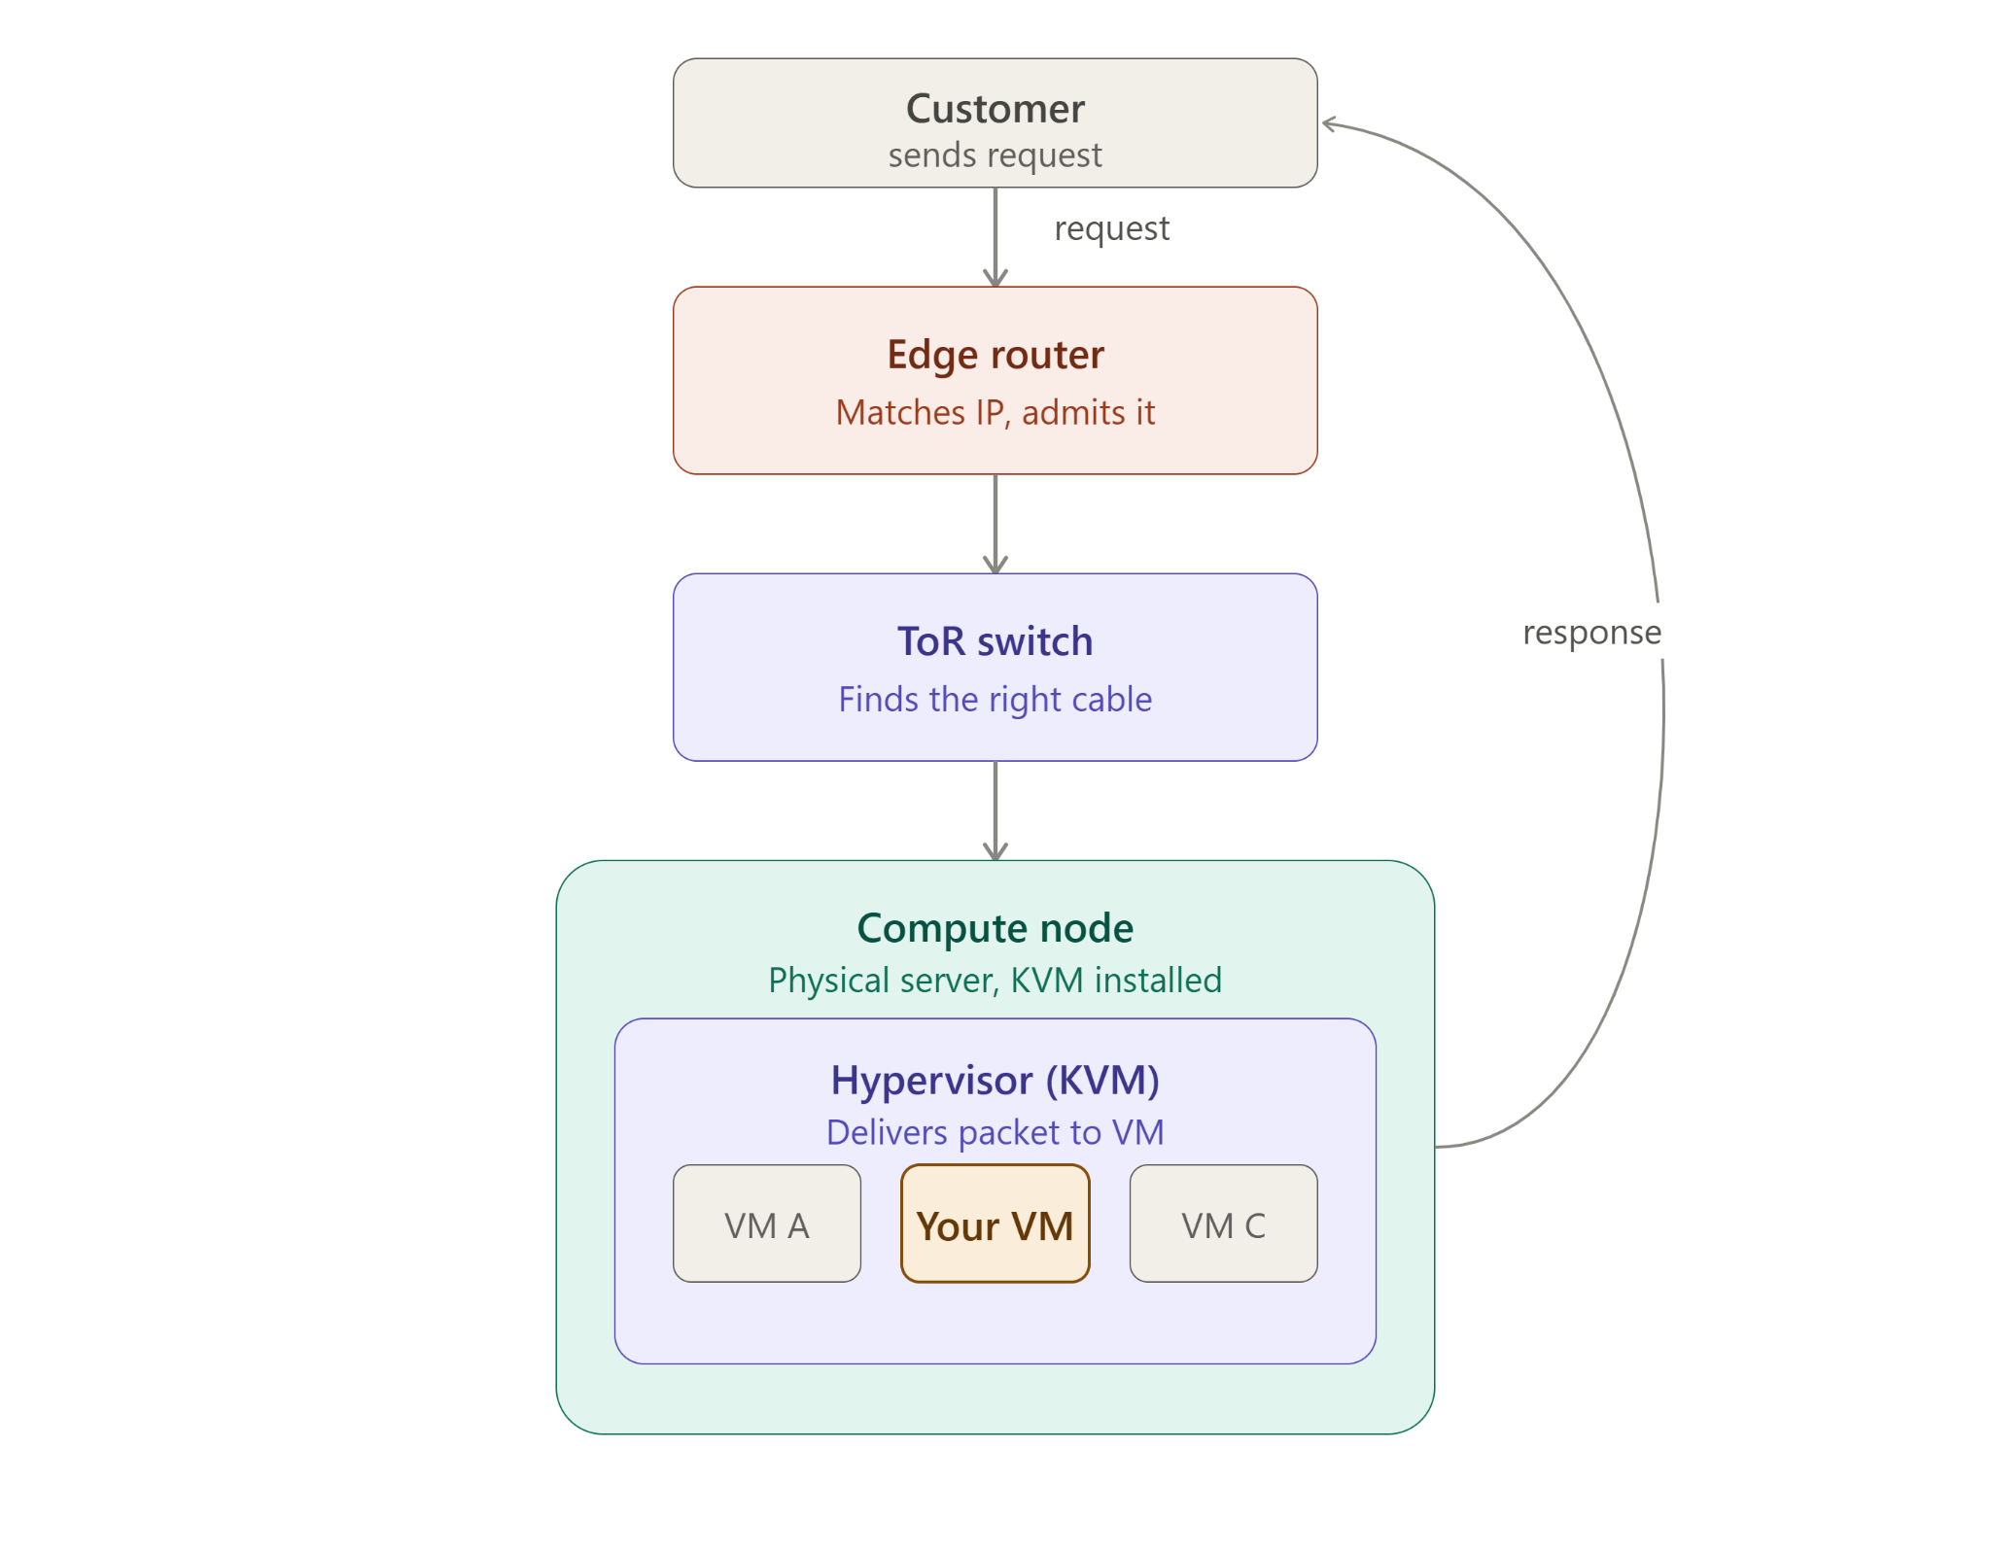
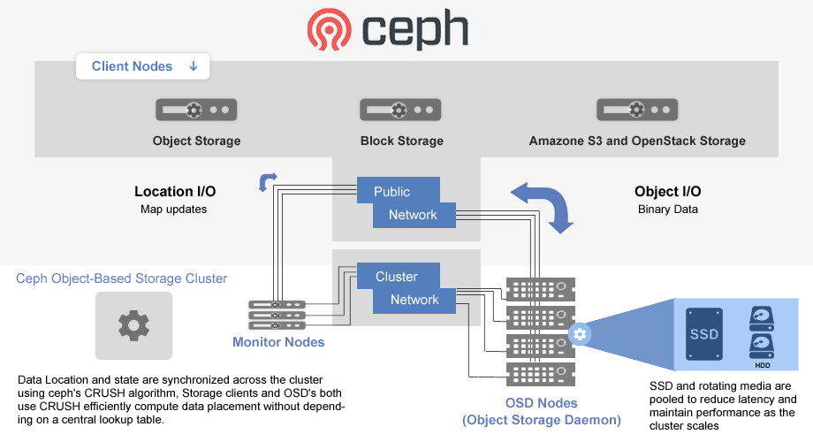
Step 1 — Physical Design: Node Roles & Hardware BOM
Design the cluster topology on paper before purchasing a single server
Notes:
Achieving Data Sovereignty for EU Enterprises Through European Cloud Infrastructure: A Comparative Analysis of Technical Capabilities and Regulatory Compliance

Slide 13
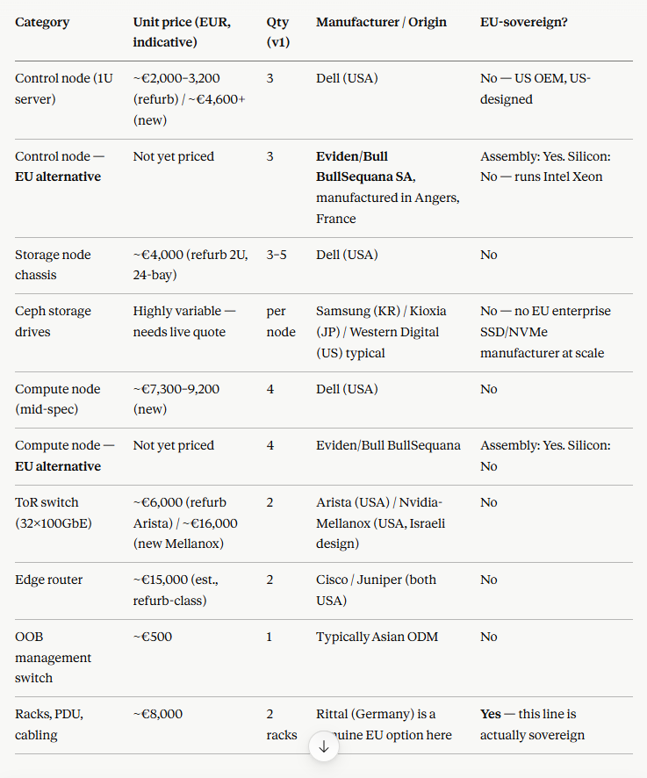
Step 1 — Physical Design: Node Roles & Hardware BOM
Hardware sovereignity concerns – Manufakturen & Produced
Notes:
Achieving Data Sovereignty for EU Enterprises Through European Cloud Infrastructure: A Comparative Analysis of Technical Capabilities and Regulatory Compliance

Slide 14
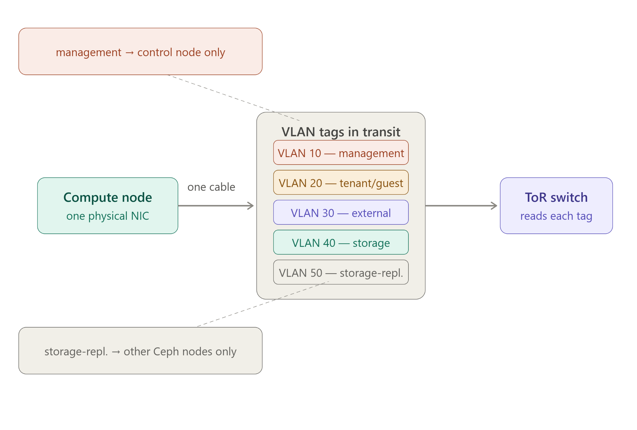
Step 2 — Network Underlay: Separating Traffic into Isolated Lanes
VLAN tagging is how one physical wire carries multiple completely separate conversations
Servers communicate over physical cables. Mixing different types of traffic (management, storage, tenant data) on the same wire is both a security risk and a performance risk. The solution: VLAN tagging — every packet gets a small tag stamped on it saying which network it belongs to. The switch reads the tag and keeps conversations apart.
VLAN 10 — Management / OOB
SSH, IPMI/BMC access, Ansible playbooks, SRE remote access
VLAN 20 — OpenStack Control Plane (APIs)
Keystone, Nova, Neutron, Glance, Cinder API traffic
VLAN 30 — Ceph Storage / Replication
OSD-to-OSD replication, client-to-OSD storage I/O
VLAN 40 — Tenant / VM Data (East-West)
VM-to-VM traffic inside customer virtual networks (VXLAN overlay)
VLAN 50 — External / Internet (North-South)
Customer VMs reaching the internet; DE-CIX peering uplink
The switch reads the VLAN tag on arrival and decides where the packet is allowed to go next — traffic from VLAN 30 (storage) never reaches VLAN 40 (tenant), even on shared physical cables.
Notes:
Achieving Data Sovereignty for EU Enterprises Through European Cloud Infrastructure: A Comparative Analysis of Technical Capabilities and Regulatory Compliance

Slide 15
Step 3 — Installing OpenStack: Turning Bare Metal into a Cloud
Kolla-Ansible packages OpenStack services as containers — installed in a strict dependency order
Kolla-Ansible SSHes into every server and installs the necessary containers in this order:
1. KEYSTONE — Identity & Authentication
The first service installed. Every other OpenStack service must prove its identity to Keystone before it can do anything. Nothing works without it.
↓
2. GLANCE — Image Service
Stores VM templates (e.g. 'Ubuntu 22.04' disk image). Nova will later clone these images onto compute nodes to create new VMs.
↓
3. NEUTRON — Networking Service
Configured with the actual VLAN ranges from Step 2. Creates virtual networks, routers, security groups — the networking fabric for all tenant VMs.
↓
4. NOVA — Compute Service
Once identity, images, and networking exist, Nova does its real job: receive a 'give me a VM' request, pick a compute node, and boot it via KVM.
↓
5. CINDER — Block Storage
Wired to talk to the Ceph storage nodes. Provides persistent VM disks that survive VM restarts — backed by Ceph pools for resilience and redundancy.
Notes:
Achieving Data Sovereignty for EU Enterprises Through European Cloud Infrastructure: A Comparative Analysis of Technical Capabilities and Regulatory Compliance

Slide 16
Step 4 — First Boot: Standing Up the Cloud for Customer Zero
OpenStack is running — now configure it and prove it works
① Define Tenant Network
② Upload Base Image via Glance
③ Define Flavors (VM Sizes)
Use Neutron to create the customer's virtual network: private IP range, virtual router, external gateway. This is where the VLAN plan from Step 2 becomes a concrete, usable network.
Upload an Ubuntu or Debian disk image. This is the template Nova clones every time a new VM is requested. One image → unlimited VMs.
Nova's term for VM sizes — your product catalogue: e.g. 2 vCPU / 4GB RAM · 8 vCPU / 32GB RAM · 32 vCPU / 128GB RAM. These are the sizes Customer Zero (and future customers) can request.
④ Create Cinder Volume Types
⑤ Boot the First Test VM — the 'Does This Work?' Moment
⑥ Onboard Customer Zero
Map Cinder storage tiers to the Ceph pools built in Step 1 so VMs can request persistent block storage backed by Ceph.
Request a VM, watch Nova pick a compute node, Glance hand over the image, Cinder attach a disk, Neutron assign a network address. If the VM boots and answers a ping → the cloud is technically alive.
Migrate or deploy the anchor customer's actual workload onto the live cloud. Operate as an 'illusion of infinite capacity' — the mandate is to never say no when a customer asks for a machine.
Notes:
Achieving Data Sovereignty for EU Enterprises Through European Cloud Infrastructure: A Comparative Analysis of Technical Capabilities and Regulatory Compliance

Slide 17
Canonical Products & Reference Adopters
Open-source sovereign cloud at every scale
OpenStack
Ceph
KVM
MAAS
Ubuntu
MicroCloud / Canonical OpenStack
Distributed Storage
Kernel-based Virtual Machine
Metal as a Service
OS Base Layer
Open-source cloud operating system. Controls large pools of compute, storage, and networking resources across a data centre. Scales from a 3-node lab to a hyperscale deployment.
Data sovereignty is not only a location question. Ceph provides: • Verifiable data placement • Cloud-compatible storage under your own control • Resilience by design • No dependency on proprietary storage platforms
The 'centre of gravity' of open virtualization. KVM is a Linux kernel module — not controlled by any single company. Many organisations contribute to it. The hypervisor of choice for AWS, Alibaba, IBM, Oracle.
Operational sovereignty starts at the metal. MAAS provides bare-metal provisioning and full hardware lifecycle control — discover, commission, deploy, and decommission servers remotely via API. No manual BIOS work.
The open-source OS underpinning the entire stack — from bare metal to container runtime. Long-term support (LTS) releases, security patching, and Canonical's commercial support contracts provide enterprise-grade SLAs.
Reference Adopters of Canonical Sovereign Stacks
UNICC
United Nations International Computing Centre
UIDAI
Unique Identification Authority of India
Sovereign cloud for UN agencies globally
Digital identity infrastructure for 1.4+ billion people
Notes:
Achieving Data Sovereignty for EU Enterprises Through European Cloud Infrastructure: A Comparative Analysis of Technical Capabilities and Regulatory Compliance

Slide 18
Key Takeaways
Canonical · Building Sovereign Cloud · July 2026
1
Sovereignty is driven by geopolitics, regulation, and economics — not just compliance.
The threat is strategic: lock-in pricing, foreign jurisdiction, and supply-chain risk are existential for mission-critical infrastructure.
2
Know your legal instruments.
Regulations (GDPR, DORA, CRA) apply directly and uniformly. NIS2 is a Directive — reach you through 27 different national laws.
3
Sovereignty is a full-stack property.
Hardware → OS → virtualization → networking → storage → observability → application. A sovereign app on a non-sovereign layer below it is NOT sovereign.
4
Open source is the natural foundation — but necessary, not sufficient.
KVM, OpenStack, Ceph, and Ubuntu give you freedom from vendor lock-in. Operations, data placement, and the full stack must also be under your control.
5
Build in phases: Customer Zero → IaaS → thin managed services → certify.
Start in colocation, with OpenStack + Ceph + KVM + Kolla-Ansible. Hire the six critical profiles — talent scarcity is itself a sovereignty constraint.
6
Operational sovereignty starts at the metal.
MAAS for hardware control. Kolla-Ansible for repeatable deployment. The 'illusion of infinite capacity' is the operating mandate.
Notes:
Achieving Data Sovereignty for EU Enterprises Through European Cloud Infrastructure: A Comparative Analysis of Technical Capabilities and Regulatory Compliance

